Slide 1
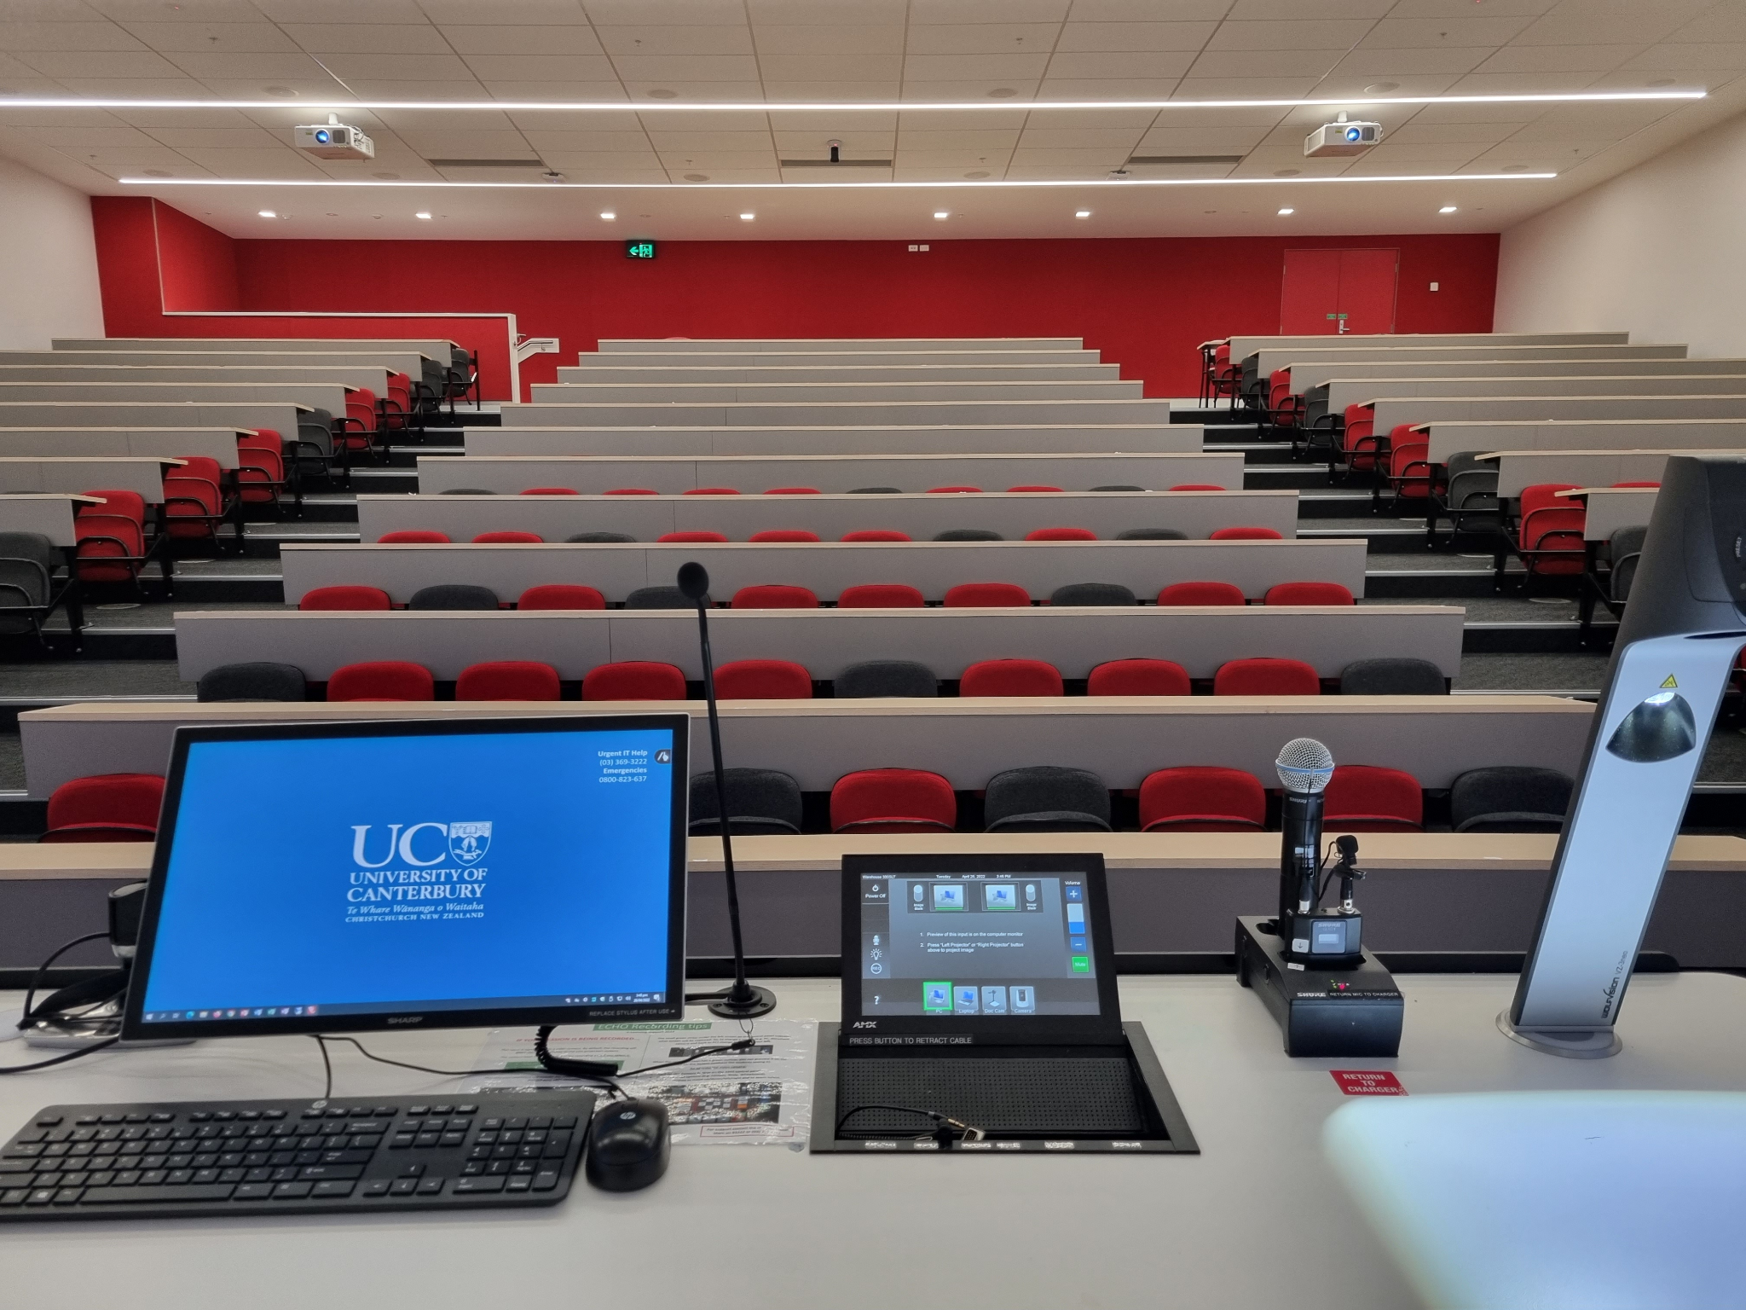


Application of Engineering Process to fix K1 Lecture Theatre’s Seating
Elizabeth Reeve
Eva Donkin
Liam McCord
Michael Brown
Philip Brand

Slide 2
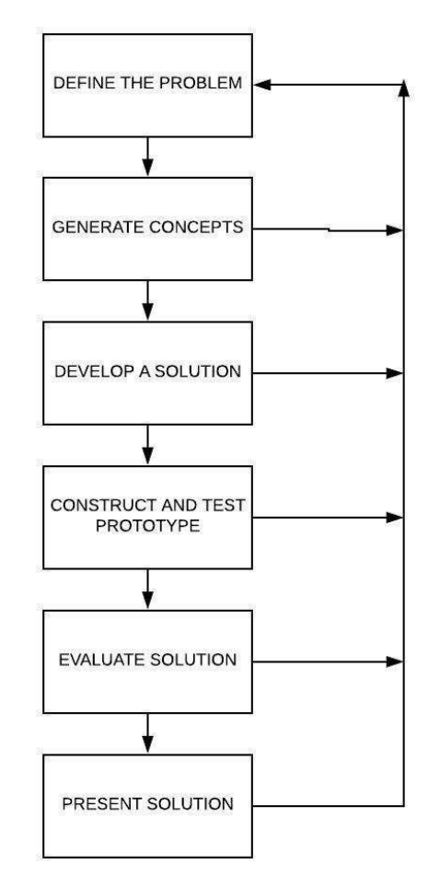
Engineering Process
1
2
3
4
(We all know this)
5
6

Slide 3
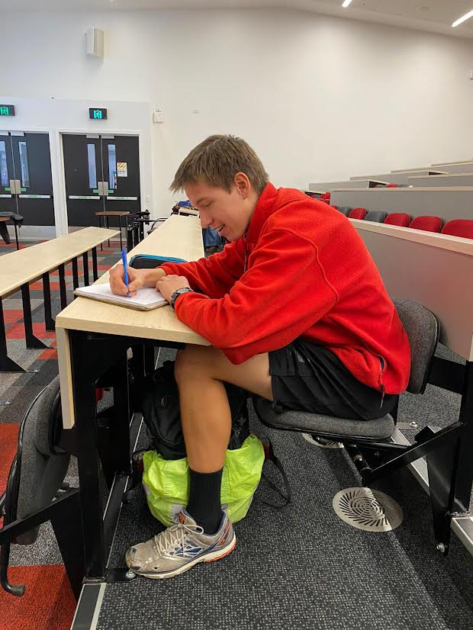
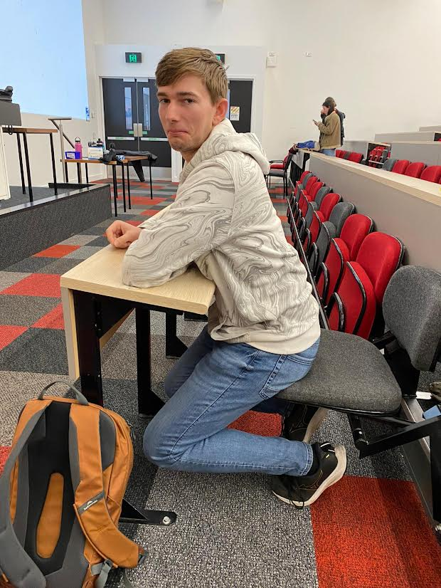
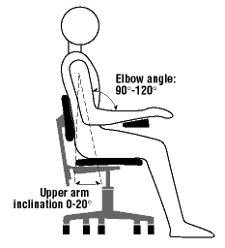
Step 1: Introduction to the problem

Slide 4




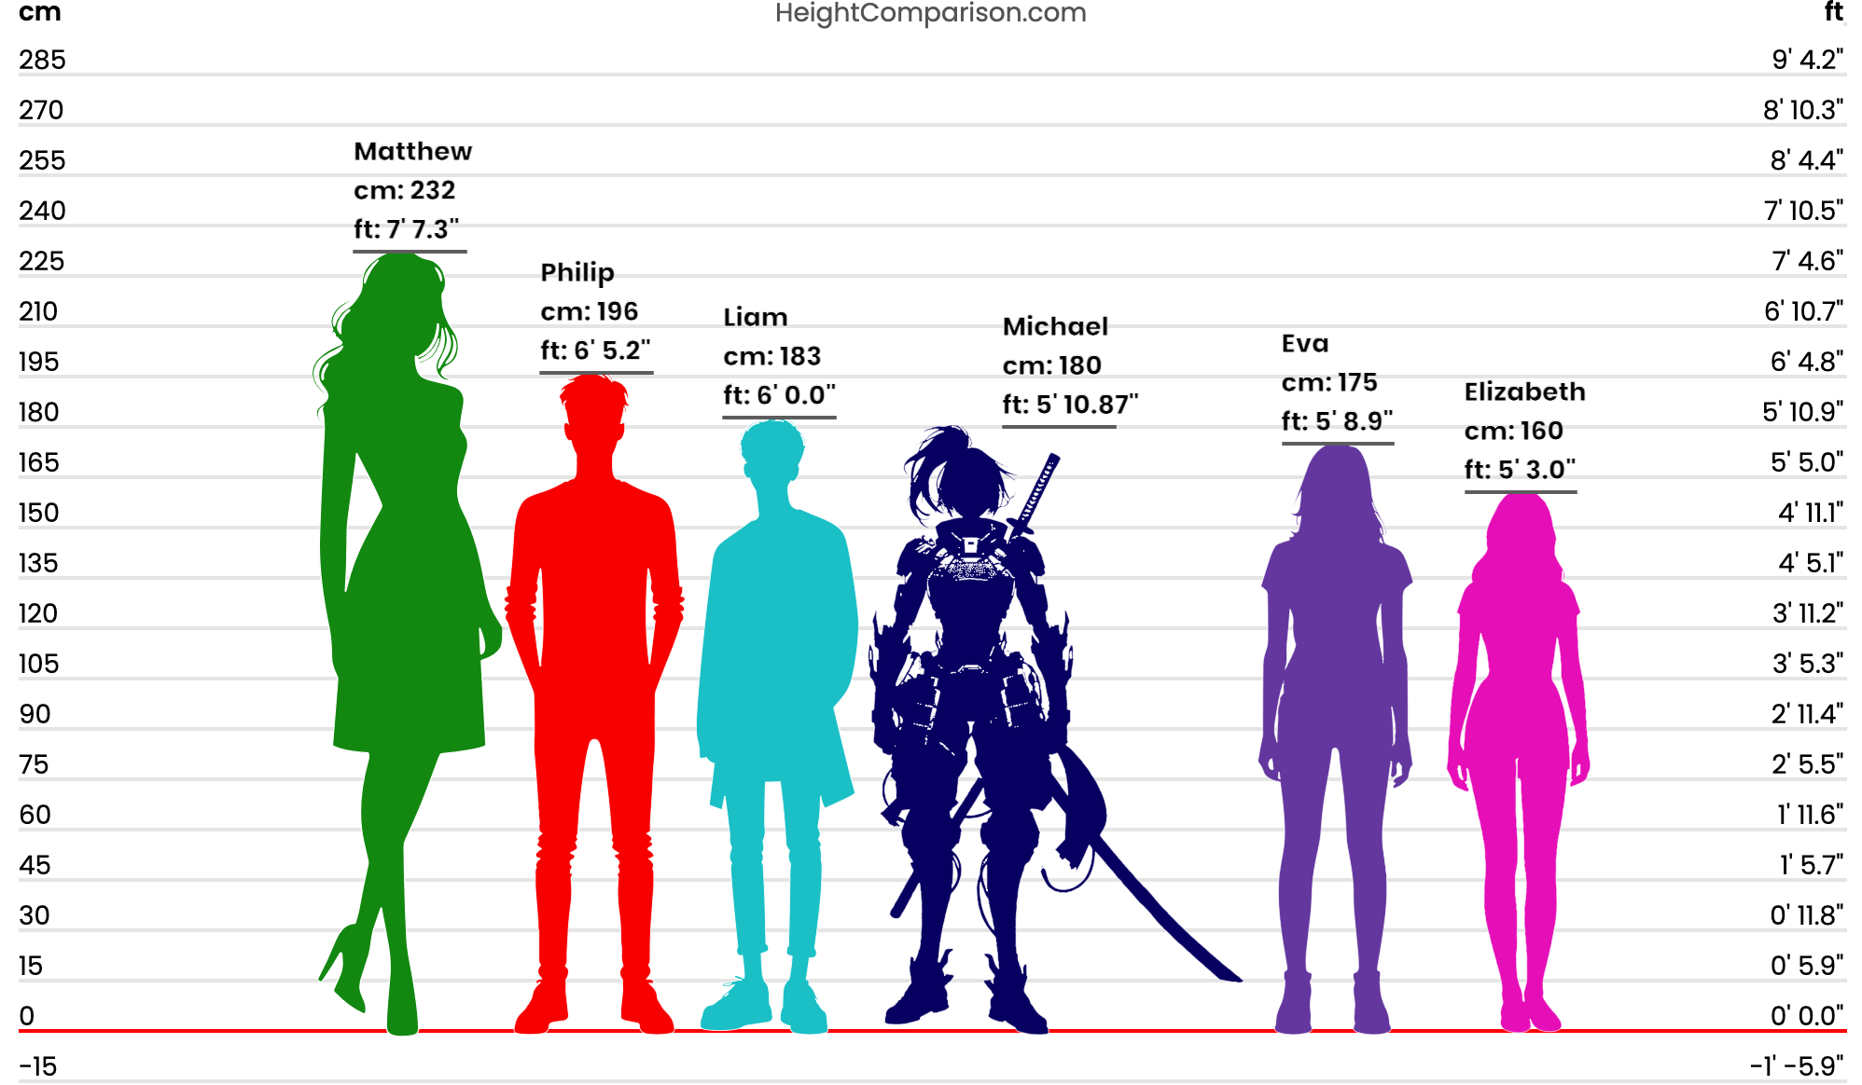

Step 1: Requirements and Constraints
Cost
Time to implement
Functionality
Comfort
Versatility
Longevity

Slide 5
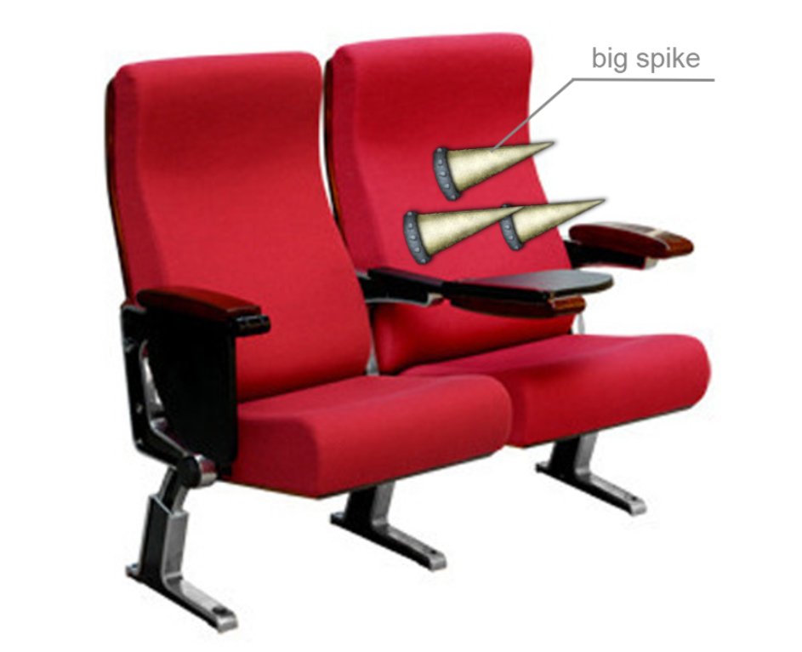
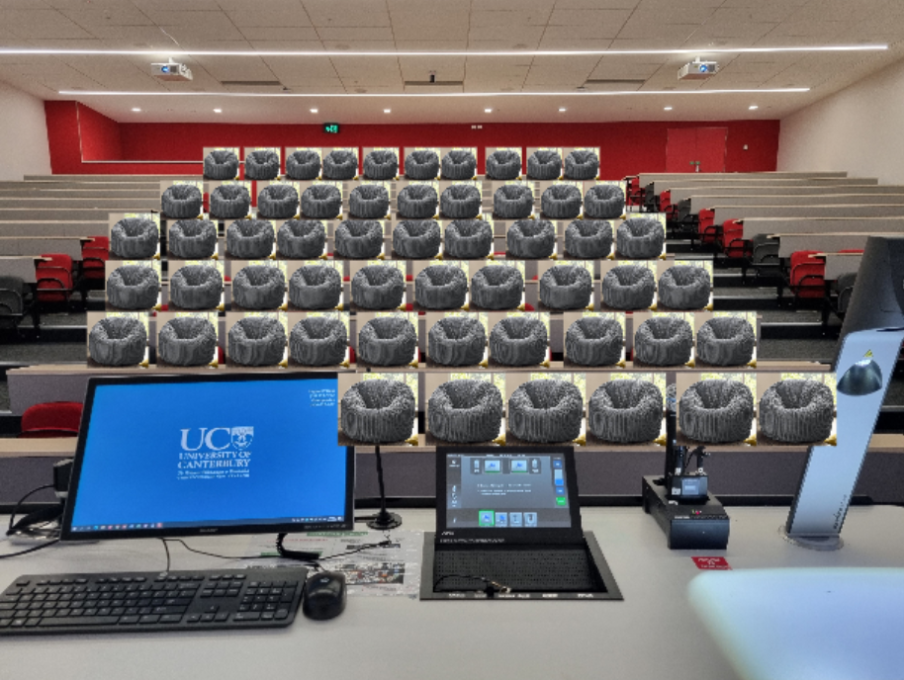
Step 2: Develop Potential Solutions
Main goal: decrease distance between chair and table
Implement chairs that force good posture
Replace chairs with bean bags
Move the table/chair units
Increase depth of table tops

Slide 6
KT Table
Constraints | Time to implement | Cost (labour and materials) | Functionality | Comfort | Versatility for varying body types | Longevity | Total score=∑score*weighting
Constraints weighting | 2 | 3 | 5 | 4 | 3 | 4 | -
Move chairs forward | 2 | 2 | 3 | 3 | 2 | 3 | 55
Move tables back | 3 | 3 | 3 | 3 | 2 | 3 | 59
Change table tops | 3 | 3 | 4 | 4 | 3 | 4 | 76
Replace chairs with beanbags | 3 | 3 | 1 | 4 | 4 | 1 | 52
Implement chairs that force good posture | 2 | 1 | 4 | 5 | 2 | 3 | 65

Slide 7
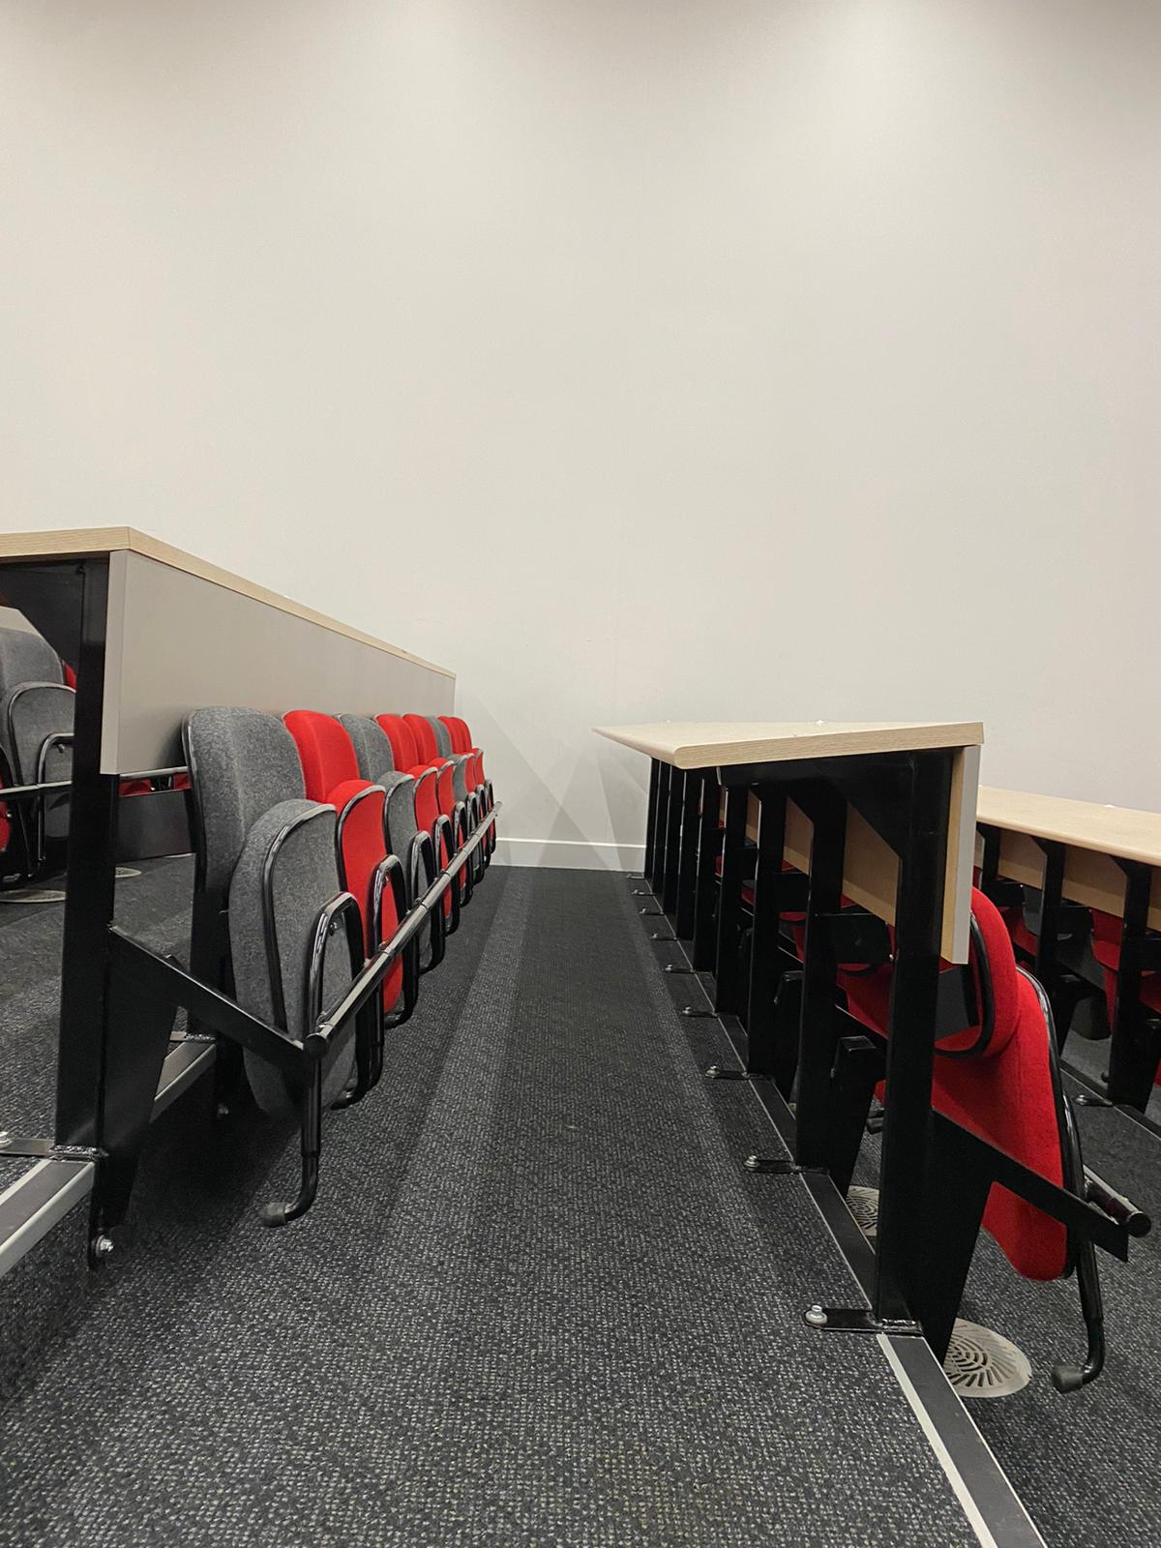
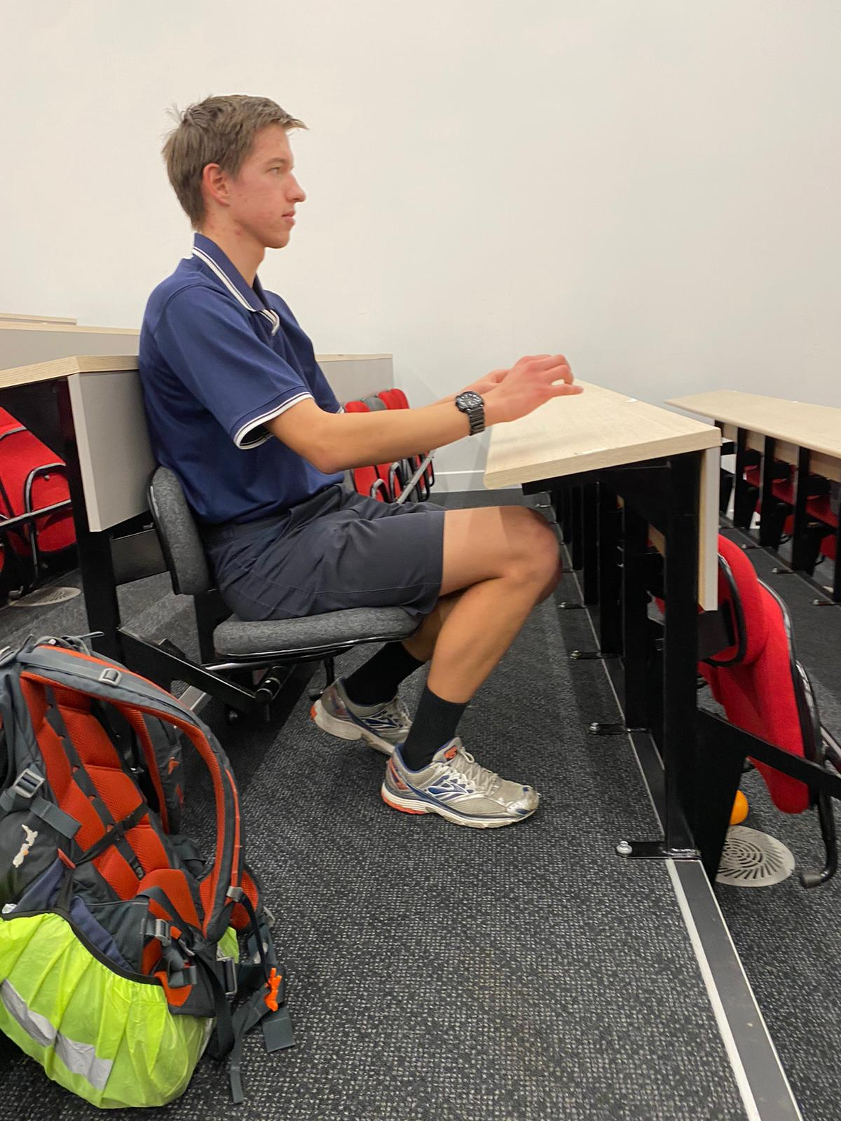
Step 3: Proposed Solution
Lines show new tabletop position

Slide 8
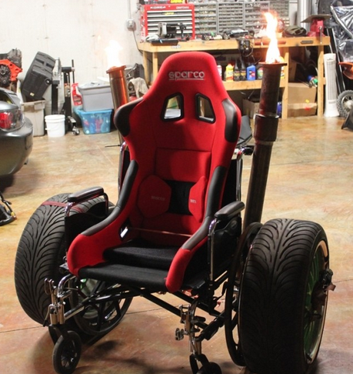
Step 4: Planned Further Development
Further Steps
Constructing Prototypes
Design for Manufacturing
Seek feedback before implementation
L E G

Slide 9
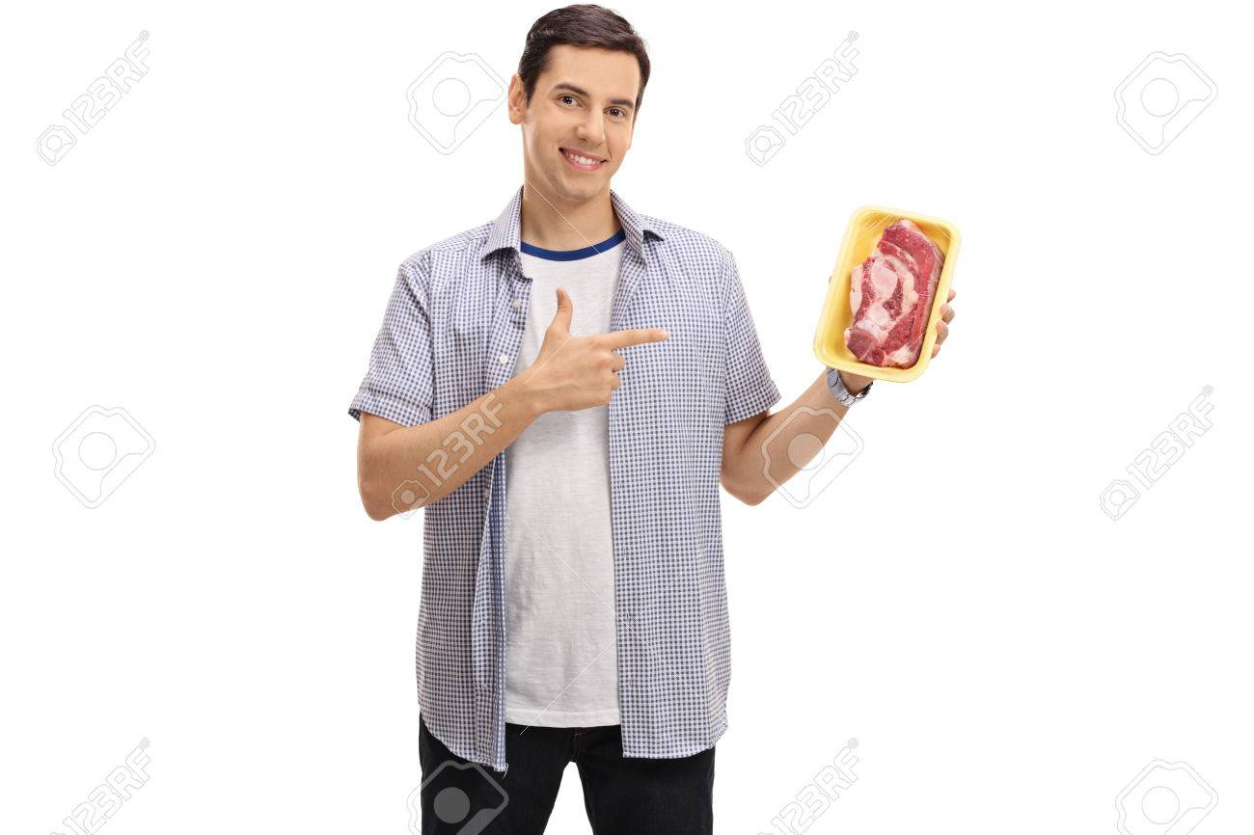
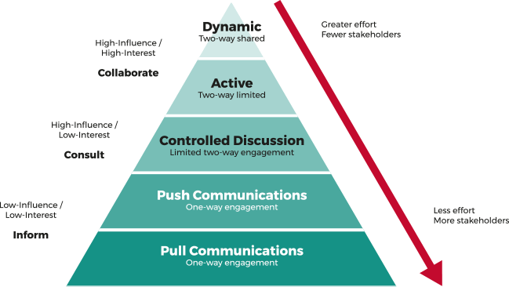
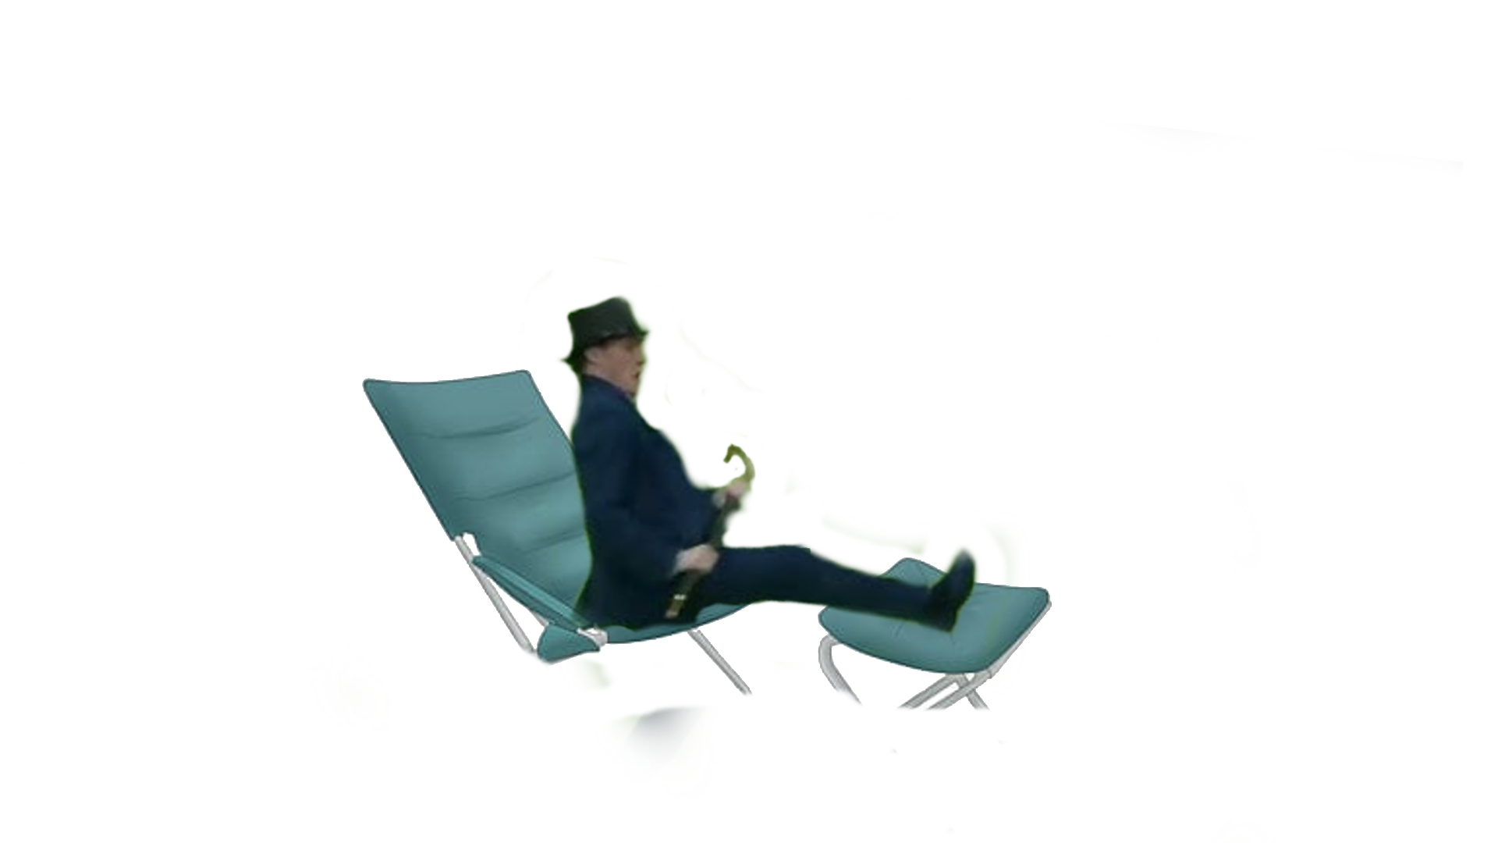
Learning Outcomes
A Happy Steak-Holder
“This doesn’t fit me!” >:(
Please consult your stakeholders!

Slide 10
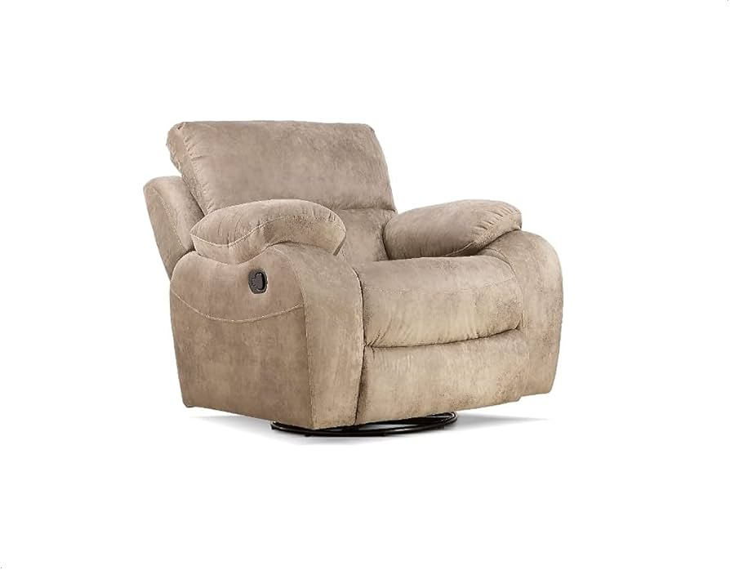
Any questions?

